Slide 1
The Periodic Table

Slide 2

Match the following definitions with the correct property.
Properties
Definitions
Conductivity
Ductility
Flammability
Hardness
Luster
Malleability
Oxidation
Reactivity with water
Sensitivity to light
Solubility
Toxicity
A resistance to being scratched or dented.
The ability to reflect light.
The ability to be stretched into wires.
The ability to catch on fire.
The ability to be hammered into a flat sheet.
The ability to react with water.
The ability to dissolve in a liquid.
The ability to be poisonous.
The ability to react with oxygen.
The ability to change when exposed to light.
The ability to pass electricity or heat through a substance.
Notes:
1) K 2) C 3) D 4) A 5) B 6) E 7) I 8) F 9) J 10) G 11) H

Slide 3
Match the following definitions with the correct property.
Properties
Definitions
k
Conductivity
Ductility
Flammability
Hardness
Luster
Malleability
Oxidation
Reactivity with water
Sensitivity to light
Solubility
Toxicity
A resistance to being scratched or dented.
The ability to reflect light.
The ability to be stretched into wires.
The ability to catch on fire.
The ability to be hammered into a flat sheet.
The ability to react with water.
The ability to dissolve in a liquid.
The ability to be poisonous.
The ability to react with oxygen.
The ability to change when exposed to light.
The ability to pass electricity or heat through a substance.
c
d
a
b
e
i
f
j
g
h
Notes:
1) K 2) C 3) D 4) A 5) B 6) E 7) I 8) F 9) J 10) G 11) H

Slide 4
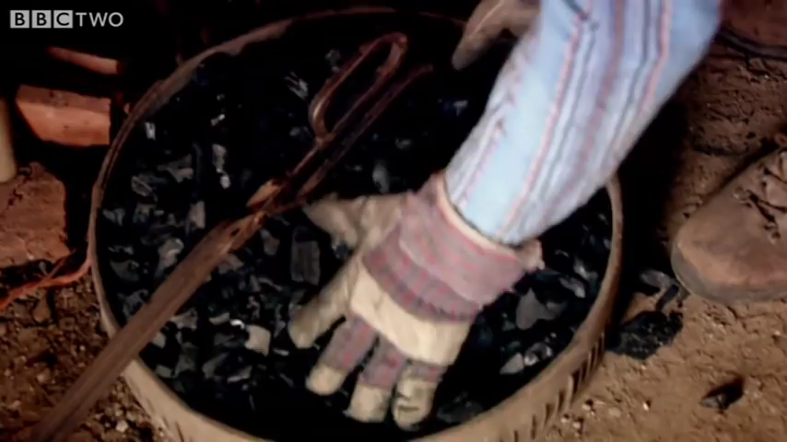

Slide 5
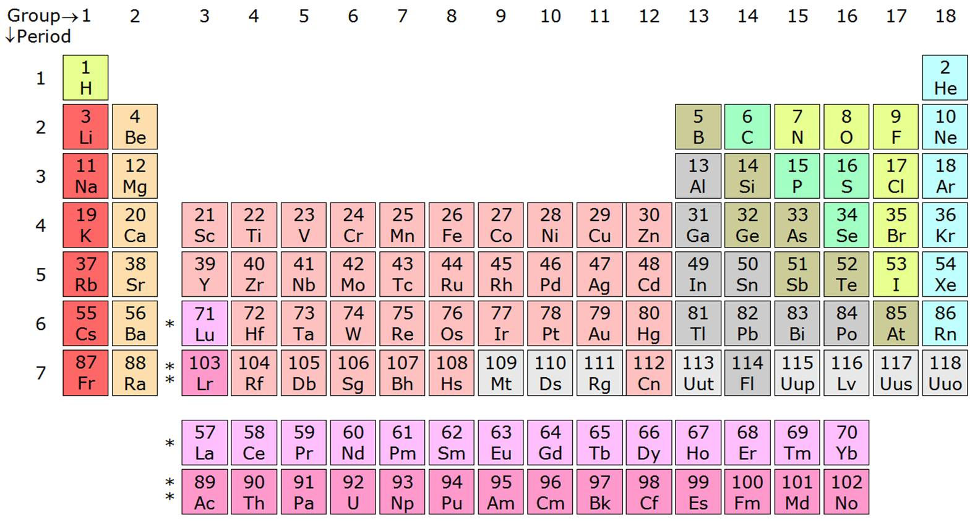
The Periodic Table

Slide 6
What are elements?
An element or chemical element is the simplest form of matter in that it cannot be further broken down using any chemical means.

Slide 7
FACTS!
A necessary prerequisite to the construction of the periodic table was the discovery of the individual elements. Although elements such as gold, silver, tin, copper, lead and mercury have been known since antiquity, the first scientific discovery of an element occurred in 1649 when Hennig Brand discovered phosphorous.
New elements named in June 2016.
- Ununtrium (Uut), ununpentium (Uup), ununseptium (Uus), and ununoctium (Uuo)

Slide 8
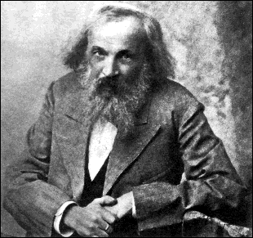
History
In 1869, the Russian chemist Dmitri Mendeleev started to develop the periodic table.
the chemical elements are arranged by atomic mass.
He predicted the discovery of other elements and left spaces for the periodic table for them.

Slide 9
The Periodic Table

Slide 10
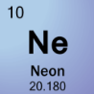
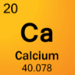
What is the Periodic Table?
A table of the chemical elements arranged in order of atomic number.
Provides the name and chemical symbol of every element

Slide 11
What is the Periodic Table?
The different rows of elements are called periods. Periods are arranged by their increasing atomic weight.
The vertical columns on the periodic table are called groups. Elements in the same group have similar chemical properties

Slide 12
What are elements?
All elements have a Latin name, which is where the symbols are derived from.
Eg: The Latin word for lead in plumbum, hence the symbol Pb.
The symbols for elements always have a capital, with letters following in lower case.

Slide 13
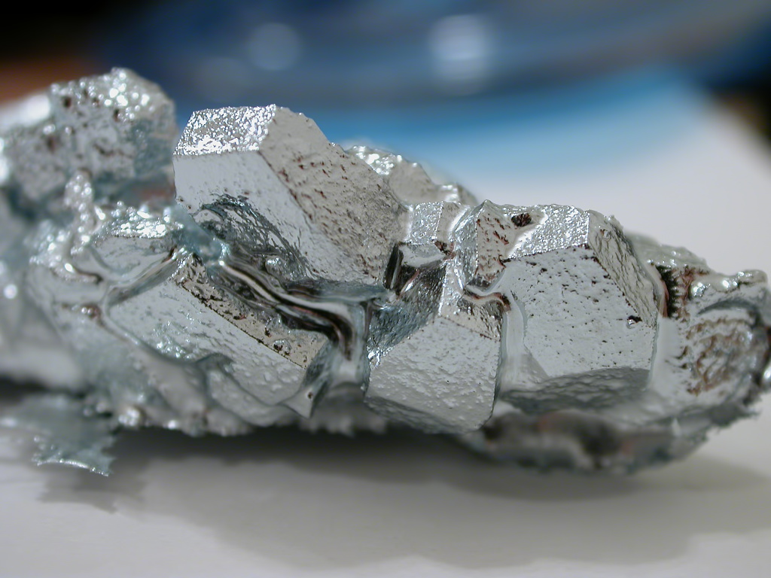
Element Classification
Metal -An element that readily forms positive ions and has metallic bonds -Characteristics of metal: conduct electricity, malleable and ductile
Non-Metal -An element which is not metal and does not have the same characteristics of metal
Metalloid -An element that has both metallic and nonmetallic properties

Slide 14
Just how small is an atom
https://www.youtube.com/watch?v=yQP4UJhNn0I&feature=emb_logo

